Slide 1
Classification of Neurons by Activation Stages using an Artificial Neural Network
Eric Xie
02/13/2021

Slide 2
Overview
Background Info
Algorithm Analysis
Research Progress
Future Goals and Direction

Slide 3
Research Goals
Predict activation state of a neuron using gene expression data from scRNA-seq dataset
Maximize the accuracy of prediction using artificial neural network algorithm
Improve the efficiency of computational process via optimizing the structure of the artificial neural network

Slide 4
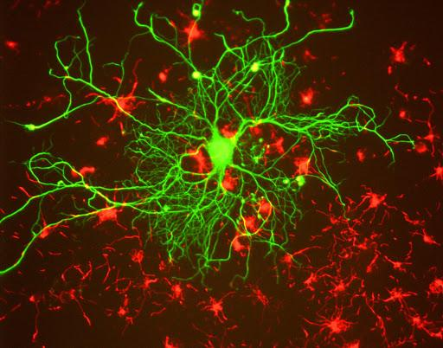
Neuron Activation
Gene expression rates increase within certain genes upon activation
Time between activation and peak expression determines early or late response.
Occurs in both excitatory and inhibitory neurons
Retrieved from http://www.sci-news.com/othersciences/nanotechnologies/nanowiring-optical-control-neuron-activation-05754.html

Slide 5
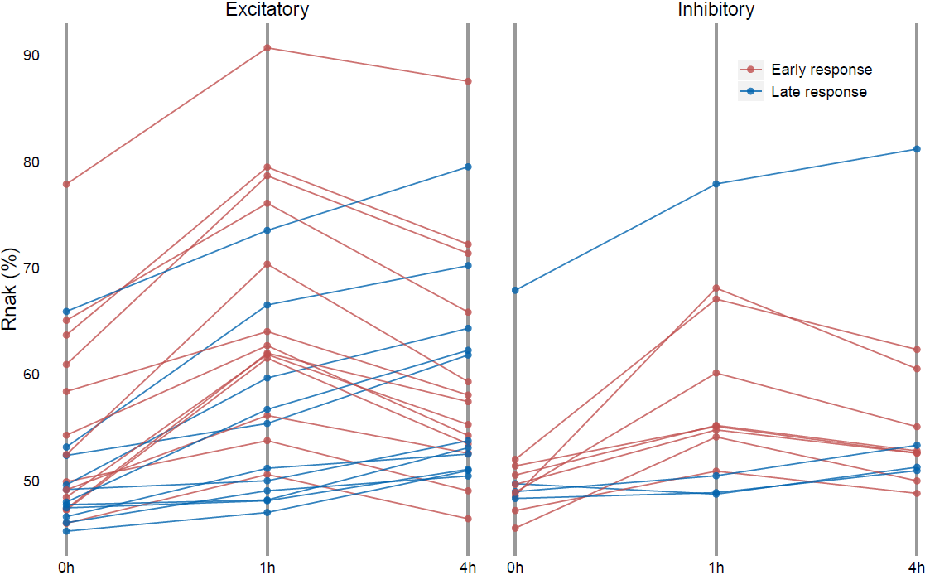
Neuron Activation
Early Response
Gene expression reaches peak between 0-1 hr
following activation
Begins decreasing after the 1 hour mark
Primarily belongs to transcription factors

Slide 6
Neuron Activation
Late Response
Gene expression peaks between 4-6 hours following activation
Occurs as a result of synaptic plasticity
Strengthening of synapses impacts learning and memory

Slide 7
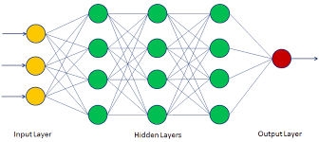
Artificial Neural Networks
A type of machine learning program
Layers of neurons holding numerical data
Made up of input layer, hidden layers, and output layer
Many types of neural network structures serving different purposes
Retrieved from https://www.datacamp.com/community/tutorials/neural-network-models-r

Slide 8
Research Design
Analysis of neuron activation data using an artificial neural network
Split whole scRNA-seq data into two sets:
Training data
Determine weights and biases
Test data
Assess accuracy of the program

Slide 9
Preliminary Code
options(stringsAsFactors = F)
Determines whether text in the files should be considered to be variables or not.
library(caret)
library(neuralnet)
Loads packages containing tools used later in the program.

Slide 10
Preliminary Code
load("Response.genes.rank.Rdata")
load("NA.induced.cell.Rdata")
load("GSE102827neuron.activity.scRNAseq.Rdata")
Loads data files into R

Slide 11
Creating Training Data
EXC_0h_index <- sample(slience_0h_cells,2222)
EXC_1h_index <- sample(early_act_1h_cells,757)
EXC_4h_index <- sample(late_act_4h_cells_v2,865)
Setting half of each dataset as a training set
sample() randomizes the input values
set.seed(12345)
Randomized values are constant when repeated using this seed

Slide 12
Creating Training Data
EXC_train <- t(data[,which(colnames(data) %in%
c(EXC_0h_index,EXC_1h_index,EXC_4h_index))])
Creates a dataset with only excitatory neurons
EXC_train <- EXC_train[,which(colnames(EXC_train)%in% rownames(EXC_rank))]
Removes cells not in the EXC_rank dataset

Slide 13
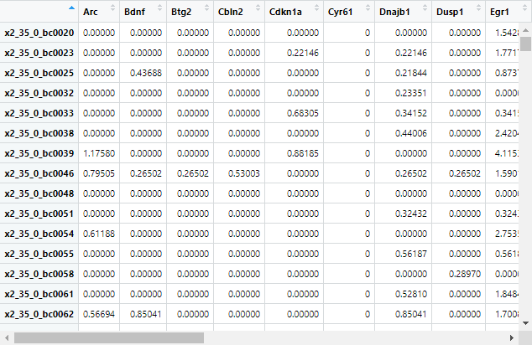
Creating Training Data
EXC_train <- as.data.frame(EXC_train)
Formats the data as a table

Slide 14
Creating Training Data
EXC_train$class <- 0
EXC_train$class[which(rownames(EXC_train) %in% EXC_1h_index)] <- 0.5
EXC_train$class[which(rownames(EXC_train) %in% EXC_4h_index)] <- 1
Classifies the activation level of each cell in EXC_train

Slide 15
Creating Test Data
EXC_test <- data[,which(colnames(data)%in% c(slience_0h_cells,early_act_1h_cells,late_act_4h_cells_v2))]
EXC_test <- t(EXC_test[,-which(colnames(EXC_test) %in% c(EXC_0h_index,EXC_1h_index,EXC_4h_index))])
EXC_test <- EXC_test[,which(colnames(EXC_test)%in%rownames(EXC_
rank))]
EXC_test <- as.data.frame(EXC_test)

Slide 16
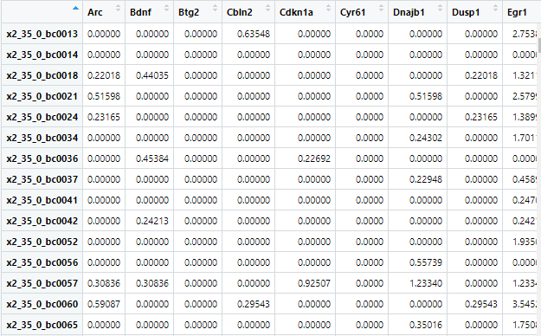
Creating Test Data

Slide 17
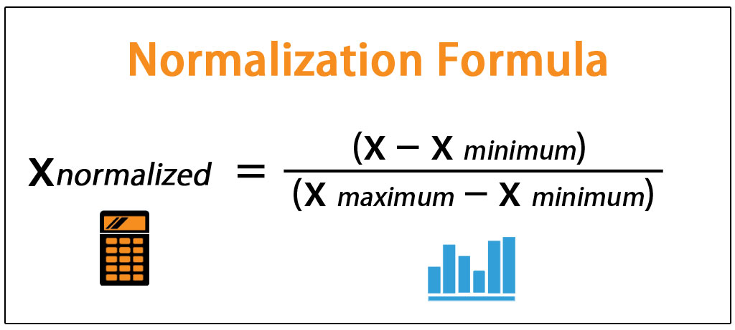
Data Normalization
normalize <- function(x) {
return((x - min(x)) / (max(x) - min(x)))
}
Creates a function (normalize) that places all values between 0 and 1
Image retrieved from https://www.wallstreetmojo.com/normalization-formula/

Slide 18
Data Normalization
EXC_train_norm <- as.data.frame(lapply(EXC_train, normalize))
EXC_test_norm <- as.data.frame(lapply(EXC_test, normalize))
Normalizes the previously created datasets

Slide 19
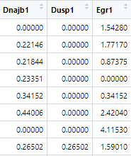
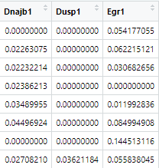
Data Normalization
Original Data Normalized Data

Slide 20
Data Normalization
summary(EXC_train_norm$class)
Gives a 5 digit summary of data
Verifies the data was normalized correctly
Result of the function:
Min. 1st Qu. Median Mean 3rd Qu. Max.
0.0000 0.0000 0.0000 0.3235 0.5000 1.0000

Slide 21
Artificial Neural Network
concrete_model2 <- neuralnet(formula = class ~Arc+Bdnf+Btg2+Cbln2...Ptgs2+Rnd3+Scg2, data = EXC_train_norm, hidden =2)
From neuralnet package
Creates a neural network
Formula - determines variables to analyze
Data - designates data frame containing formula variables
Hidden - number of hidden layers

Slide 22
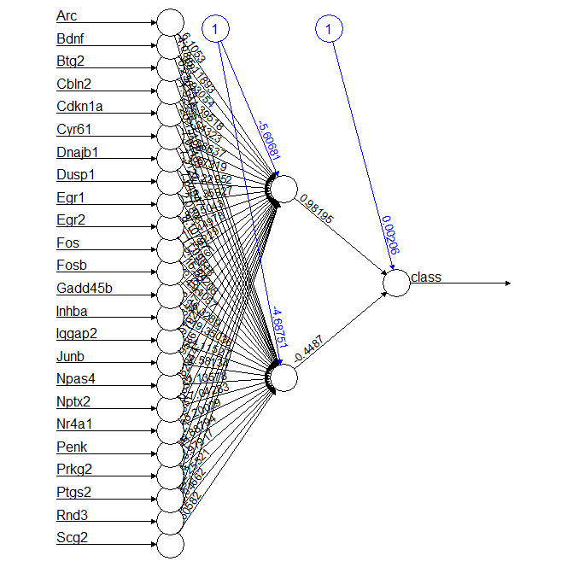
Artificial Neural Network
plot(concrete_model2)

Slide 23
Artificial Neural Network
model_results2 <- compute(concrete_model2, EXC_test_norm)
Runs the model on test data
predicted_strength2 <- model_results2$net.result
Stores the prediction values

Slide 24
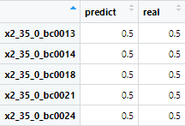
Prediction Results
EXC_result <- as.data.frame(matrix(0.5,nrow(EXC_test),2))
colnames(EXC_result) <- c("predict","real")
rownames(EXC_result) <- rownames(EXC_test)
Creates the framework for a matrix to store results in

Slide 25
Prediction Results
EXC_result$predict[which(as.numeric(predicted_strength2)<=0.33)] <- 0
EXC_result$predict[which(as.numeric(predicted_strength2)>=0.64)] <- 1
Classifies the test data off of values in predicted_strength2

Slide 26
Prediction Results
for(i in 1:nrow(EXC_result)){
EXC_result[i,2] <- info[which(rownames(info)==rownames(EXC_result)[i]), stim"]
}
Classifies each neuron’s activation state in EXC_result using the info dataset

Slide 27
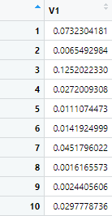
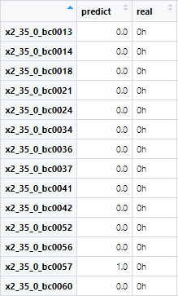
Prediction Results
predicted_strength2 EXC_result

Slide 28
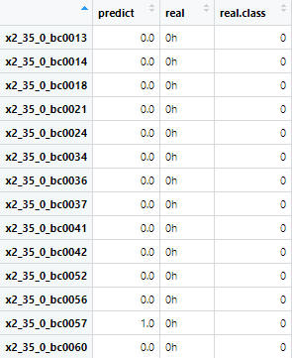
Prediction Results
EXC_result$real.class <- 0.5
EXC_result$real.class[which(EXC_result$real == "0h")] <- 0
EXC_result$real.class[which(EXC_result$real == "4h")] <- 1
Creates a new column in EXC_result
that “translates” the previous column

Slide 29
ROC Curve
library(ROCR)
library(pROC)
roc <-
multiclass.roc(EXC_result$real.class,EXC_result$predict,
percent=F)
Function imported from pROC
Finds AUC of the predict column against the real.class column in EXC_result

Slide 30
ROC Curve
plot(roc[['rocs']][[1]],xlim=c(1,0),ylim=c(0,1),col="red",cex.axis=1.5,cex.lab=1.5)
lines(roc[['rocs']][[2]],col="blue")
lines(roc[['rocs']][[3]],col="orange")
Creates a plot of the ROC curve

Slide 31
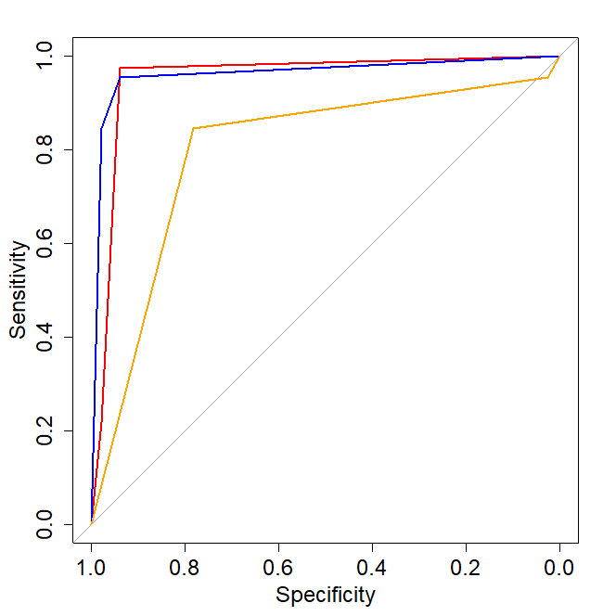
ROC Curve

Slide 32

ROC Curve
auc(roc[['rocs']][[1]])
auc(roc[['rocs']][[2]])
auc(roc[['rocs']][[3]])
From ROCR package
Finds and prints the AUC values for each variable

Slide 33
Current Progress
neuronTest <- c(1:20)
for(i in 1:20){
concrete_model2 <- neuralnet(formula = class ~Arc+Bdnf+Btg2...Rnd3+Scg2, data = EXC_train_norm, hidden =i)
...
neuronTest[i] <-(auc(roc[['rocs']][[1]])+auc(roc[['rocs']][[2]])
+auc(roc[['rocs']][[3]]))
print(neuronTest) }
Intended to find the combined AUC of ANNs with 1-20 neurons in hidden layer

Slide 34
Current Progress
Could only test with 7 neurons max in hidden layer
Algorithm did not converge in 1 of 1 repetition(s) within the stepmax.
Could not compute with the given time limit.
1 | 2 | 3 | 4 | 5 | 6 | 7
2.425 | 2.712 | 2.635 | 2.676 | 2.690 | 2.675 | 2.621

Slide 35
Current Progress
Stepmax
Determines the maximum number of times the weights are adjusted
In other words, the number of steps taken
Default is stepmax = 1e+05, or 100000
Increasing stepmax increases the computation time exponentially

Slide 36
Current Progress
Threshold
The “learning rate” of the program
Amount that the weights are adjusted every step
EX: if the threshold = 0.1, then the weights are adjusted by 0.1 or 10% of the estimated weight error each step
Increasing threshold decreases computation time at the expense of accuracy

Slide 37
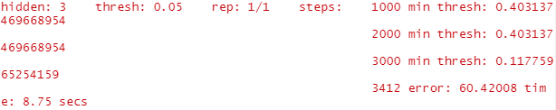
Current Progress
concrete_model2 <- neuralnet(formula = class ~Arc...Scg2,
data = EXC_train_norm, hidden =i, threshold = 0.05, stepmax = 1e+05, lifesign = "full")

Slide 38
Current Progress
1 | 2 | 3 | 4 | 5 | 6 | 7 | 8
2.425 | 2.712 | 2.635 | 2.676 | 2.690 | 2.675 | 2.621 | 2.664
9 | 10 | 11 | 12 | 13 | 14 | 15 | 16
2.638 | 2.620 | 2.634 | 2.618 | 2.614 | 2.601 | 2.606 | n/a
Result after running previous code
Reached step maximum at 16 neurons

Slide 39
Future Goals
Test different parameters
Run multiple trials at each neuron count
Research and test different artificial neuron network structures

